Slide 1

NI
Lecture
Networking Infrastructure
Virtual LAN
7
Networking Infrastructure
Diploma in CSF / IT
Year 2 (2020/2021), Semester 3
Notes:
Left-hand Bar – Replace FSP by your module code and X by the lecture number.
Replace Lecture Title
Replace < Module Name >
Replace Year and Semester if necessary

Slide 2
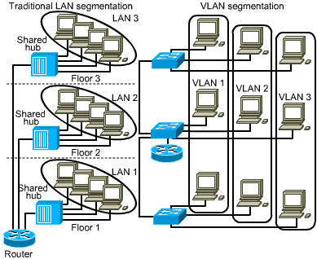
Traditional LAN Configurations
Traditionally, LAN users are grouped physically together using
Switches
A LAN includes all devices in the same broadcast domain
A broadcast domain includes the set of all LAN-connected devices that when any of the devices sends a broadcast frame, all the other devices get a copy of the frame. Hence:
LAN ≈ Broadcast Domain
Routers used to segment the LAN and provide broadcast firewalls
Switch
Switch
Switch

Slide 3

VLANs and broadcast domains
With VLANs, a switch can put some interfaces into one broadcast domain (LAN) and some into another, creating multiple broadcast domains.
These individual broadcast domains created by the switch are called virtual LANs – VLANs.
One switch, multiple broadcast domains.
VLAN 1
VLAN 2

Slide 4
Benefits of VLANs
VLANs...
control network broadcasts without having to use routers
allow users to be assigned by network admin
provide tighter network security by defining which nodes can communicate with each other
VLAN 1
VLAN 2

Slide 5
VLAN membership
VLAN 1
VLANs are formed using switches that support VLANs
Users are grouped logically by function, department or application in use
Configuration is done through software
VLAN “membership” defined by the network administrator
VLAN 2
Trunk
VLAN 2
VLAN 1

Slide 6
Creating VLANs
Two methods for implementing VLANs
Static Method
- The VLAN of a device is the VLAN that has been defined manually by the administrator for the switch port to which the device is connected.
Dynamic Method
- VLAN membership of a device is determined from the information the switch port obtained from the device, and based on some defined policies (e.g. MAC address list)

Slide 7
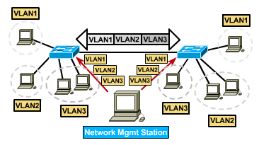
Static VLANs
Defined
Static VLANs are when ports on a switch are administratively (manually) assigned to a VLAN
Benefits
secure, easy to configure and monitor
works well in networks where moves are controlled
Notes:
Scott, H. (2099, June 22). VMPS: Put a Fork in it | Network World.
https://www.networkworld.com/article/2236203/cisco-subnet-vmps-put-a-fork-in-it.html

Slide 8
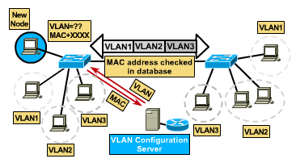
Dynamic VLANs
Defined
Switch ports can automatically determine a user’s VLAN assignment based on either/or:
MAC address
Protocol type
Application type
When you move a host from a port on one switch in the network to a port on another switch in the network, that switch dynamically assigns the new port to the proper VLAN for that host.
Benefits
less administration when users are added or move
centralized notification of unauthorized user

Slide 9
Grouping Users
VLANs can logically segment users into different subnets (broadcast domains)
Broadcast frames are only switched between ports on the switch or switches with the same VLAN ID.
Users can be logically grouped via software based on:
port number (switch port – layer 1) [ static ]
MAC address (layer 2)
network protocol being used (layer 3)
application being used (higher layer)
Notes:
Cisco switches in the lab only support grouping by port number and MAC address

Slide 10
Port-Based (Layer 1) VLAN
Groups switch ports e.g. :
port 2, 3, 5 & 8 make up VLAN A;
port 1, 4, 6 & 7 make up VLAN B
Can also group together several ports from different switches e.g. :
Port 2 & 5 from Switch 1 and Port 1, 3 & 6 from Switch 2 make up VLAN A
Port 1 & 3 from Switch 1 and Port 2, 4 & 5 from Switch 2 make up VLAN B
Disadvantage: Does not allow mobility; need to reconfigure the VLAN membership every time a user moves from one port to another

Slide 11
MAC-address Based (Layer 2) VLAN
Define by a list of MAC addresses
Group by MAC addresses
User mobility
Client & server always on the same VLAN regardless of location
Disadvantages:
Too many addresses need to be entered and managed in VLAN Management Policy Server
Performance degradation
Notes:
VLAN Management Policy Server e.g. Cisco VLAN Membership Policy Server (VMPS)

Slide 12
Network Protocol Based (Layer 3) VLAN
Take into consideration of Layer 3 protocol type
e.g. IP (Type: 0x0800)
Known as virtual subnet
Switch inspect the packet’s IP address to determine VLAN membership
Hosts do not belong to VLAN, packets do
User mobility
Disadvantage: slow performance due to inspection of packets

Slide 13
Application (Higher layer VLAN)
Different VLANs for different applications or services
e.g. FTP → VLAN1, SMTP → VLAN2, etc
Service based VLANs : all workstations using
e-mail server are on the Email VLAN, etc.
Need high level of automated configuration features

Slide 14
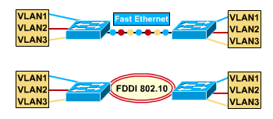
VLANs Across the Backbone
VLAN configuration needs to support trunk (backbone) transport of data across multiple switches.
The trunk is the area used for inter-switch VLAN communication
The trunk should be higher-speed links, typically 10Gbps or greater
Gigabit Ethernet
VLAN 1
VLAN 2
TRUNK
VLAN 2
VLAN 1

Slide 15
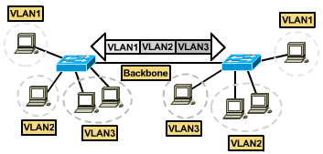
Frame Tagging
Frame Tagging...
is specified by IEEE 802.1Q which states frame tagging is the preferred way to implement VLANs
uniquely assigns a VLAN ID to each frame before it is forwarded across the trunk(backbone).
places a tag in the frame...thus, frame tagging.
is removed by the switch after frame exits the trunk(backbone) and before frame is forwarded to the end host

Slide 16
IEEE 802.1Q Frame Tag
Modified Ethernet II frame by adding a 4-byte tag between the Source MAC Address and the Type fields
First 2 of the 4 bytes contain the number 8100 (Hex) to indicate a tagged frame. This number is called the Tag Protocol ID (TPID)
The last two bytes, called Tagged Control Information, TCI, contain the
Priority Code Point, PCP (3 bits) – indicates priority of the frame
Canonical Format Indicator, CFI (1 bit) – 1 means cannot be sent to Ethernet ports that do not support tagged frames
VLAN Identifier, VID (12 bits) – 0 means does not belong to any VLAN and FFF is reserved, leaving 4094 numbers for VLAN assignment.
Note: As a result of tagging, the maximum length of an Ethernet frame can be more than 1518 bytes long for VLAN-aware devices.

Slide 17
Router’s Role in a VLAN
A router provides connection between different VLANs
Users on separate VLANs cannot communicate with one another even if on the same switch (benefit of a VLAN!)
In order for users on one VLAN to communicate with users on another VLAN, a router is needed.
If the router interface is VLAN-aware, then the router needs only one trunk link to one of the backbone switches, otherwise each VLAN needs a separate link to the router.
VLAN 1
VLAN 2
X
Trunk
X
VLAN 2
VLAN 1

Slide 18
Use of a Layer 3 switch
Note:
A Layer 3 switch is actually a Layer 2 switch that can perform routing functions.
So a Layer 3 switch can replace a Layer 2 switch plus a router.
Notes:
Layer 3 switch has better performance that router but does not have WAN interfaces

Slide 19
Reasons for using VLANs
VLANs Control Broadcasts
VLANs Allow Flexible design
VLANs Make Changes (“Moves” & “Adds”) Easier
VLANs Improve Security

Slide 20
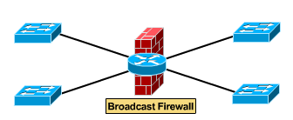
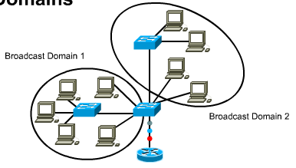
VLANs Control Broadcasts
Routers provide an effective firewall against broadcasts
Adding VLANs can extend a router’s firewall capabilities to the “switch fabric”
The smaller the VLAN, the smaller the number of users that are effected by broadcasts

Slide 21
VLANs allow more flexible design
VLANs allow flexible designs that group users by department or by groups that work together, instead of by physical location.
Sales
Admin
Marketing

Slide 22
VLANs Make Changes Easier
User moves
20% to 40% of work force moves every year
net admin’s biggest headache
largest expense in managing networks. Moves may require...
recabling
readdressing and reconfiguration
VLANs provide a way to control these costs. If the user is moved to a new location but still need to belong to the same VLAN,
simply configure the new switch port to that VLAN
router configuration remains intact

Slide 23
VLANs Improve Security
VLANs increase security by ...
confining broadcast to users in the same VLAN (ordinary users will find it harder to deduce the network topology)
restricting number of users in a VLAN
preventing user access without authorization
control access by
MAC addresses
protocol types
application types

Slide 24
Conclusion
VLANs – allow the formation of virtual workgroups; better security; improved performance; simplified administration and reduced costs
Users can be logically grouped based on Layer 1, 2, 3 or higher layers
Tagging allows a switch to determine the source and destination VLAN ID for each frame

